Slide 1
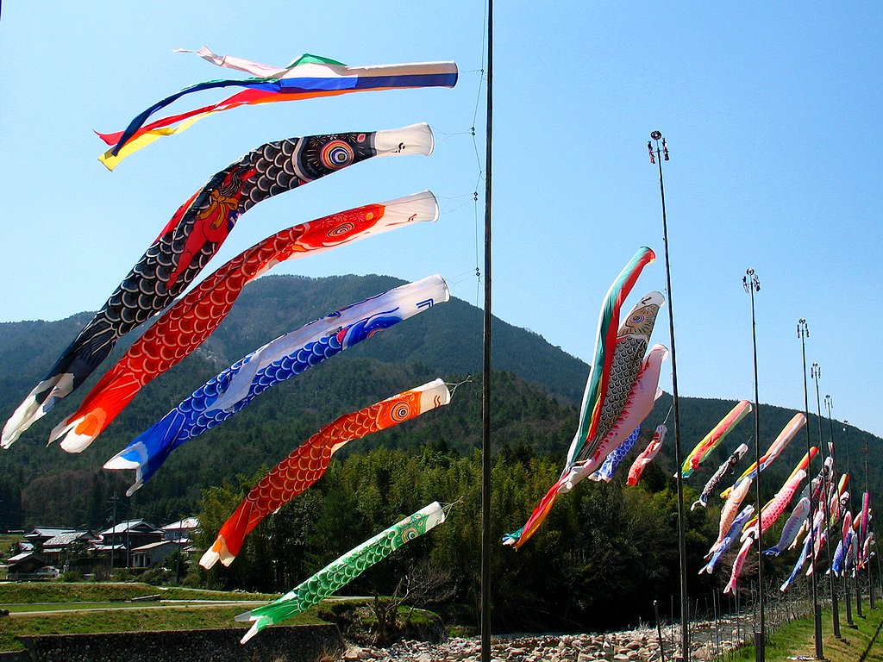
Children’s Day
(kodomo-no-hi)
Created by Miss Musser for Diversity Course: EPI 0030 Instructor: Barbara Wright

Slide 2
The History of Children’s Day In Japan
This is a national holiday in Japan celebrated on May 5th. Started in 1948, Children's Day is a festive day dedicated to celebrating the health and happiness of all children. The holiday is believed to have begun in china where they would hang medicinal herbs to ward off childhood diseases.
In Japan it is often celebrated by giving children kites and hanging streamers. In Japan, the Children's Festival was originally called the “Boy's Festival” while the girls had the “Doll Festival”(March 3rd).

Slide 3
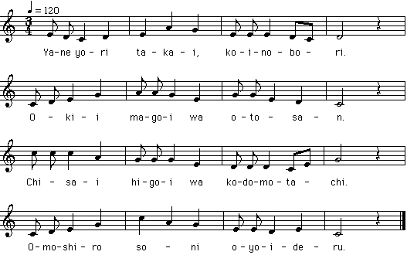
On Children's Day, children fly kites - often in the shape of carp. Carp are strong and brave fish that swim upstream, so Japanese parents want their children to be strong and brave like the carp. Here is the Koinobori (Carp streamers) song. Words by KONDO Miyako, Music by Unknown Author
(English Translation) Carp streamers are higher than the roof The biggest carp is the father The small carp are children Enjoying swimming in the sky.

Slide 4
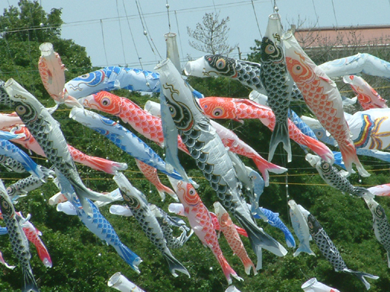
Japanese Carp Kites Koinobori, literally means “koi = carp and nobori = to climb”
These tubular kites when they catch the wind are suppose to represent carp swimming upstream.

Slide 5
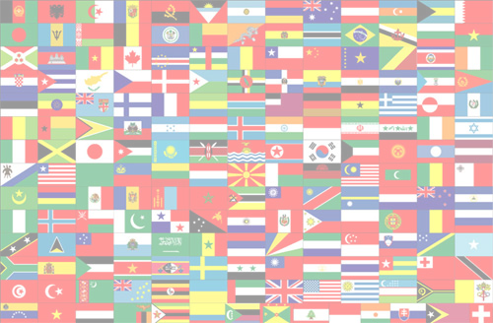
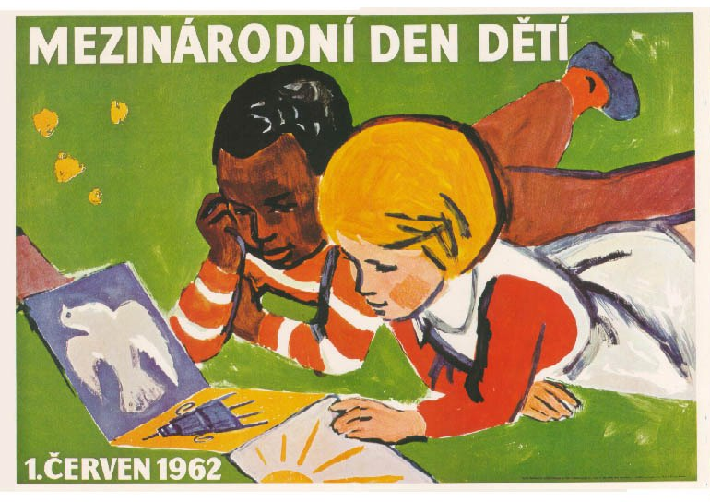
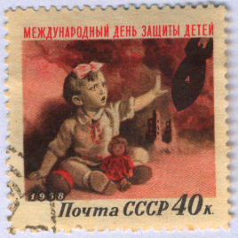
International Children's Day
International Children's Day (ICD) is celebrated in numerous countries, usually (but not always) on June 1 each year. ICD had its origin in the World Conference for the Wellbeing of Children in Geneva, Switzerland in 1925. It is not clear as to why June 1 was chosen as the ICD: one theory has it that the Chinese consul-general in San Francisco, California (USA) gathered a number of Chinese orphans to celebrate the Dragon Boat Festival in 1925, which happened to be on June 1 that year, and also coincided with the conference in Geneva.
The United States has adopted June 1 as the official International Children's Day. More than 30 states actively participate in the celebration.
Czechoslovak poster celebrating the International Children's Day
1958 USSR stamp, commemorating the International Children's Day

Slide 6
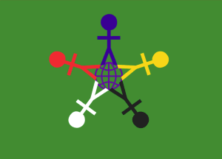
International Children's Day flag:
The GREEN background symbolizes growth, harmony, and freshness. We are surrounded by the ability to grow. All we have to do is reach out and embrace it.
The RED & YELLOW, BLACK & WHITE figures represent diversity and tolerance. Our children are the key to peace and tolerance of: race, religion, physical, mental, and social diversity.
The STAR, which is made up of the figures’ legs, represents light. We can be a light for the world, if we choose. The five points on the star represent the continents. We are all part of one true race, the human race.
The EARTH figure, which is directly in the center, represents our earthly home and all the blessings on it, which God has given us all to share and respect. The large blue circle engulfing the figures symbolizes peace and God's universal love. It also represents the unity that we can achieve if we reach out to one another in love.
The BLUE symbolizes trust, loyalty, wisdom, confidence, intelligence, faith, truth, and heaven. The blue figure at the top represents God, who is the author & finisher of all things. God loves all of us equally and we should be striving to imitate that love (which is represented by the figures reaching out to each other)
Many states in the United States of America have adopted this flag as a symbol for International Children's Day. It is being manufactured.

