Slide 1
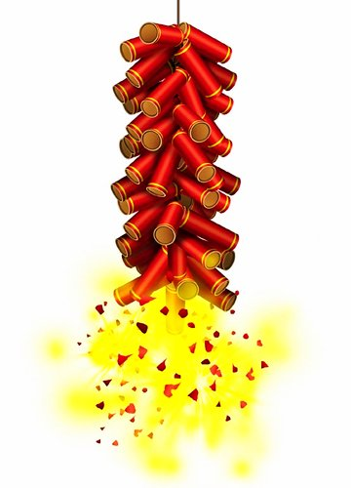
Chinese New Year
Also called the Spring Festival
Celebrates the earth coming back to life and the beginning of the growing cycle
On the 1st day of the 1st lunar month
Celebrations include feasts, parades, lion dances and fireworks
The holiday continues for 15 days! Ends with the first full moon of the year and the Lantern Festival
Notes:
Celebrated for over 4,000 years
Through the years, they have had different functions and served as a means of communication. Red Lanterns have traditionally been a sign of joy and vitality, when placed on the doorways, it was a way of participating a birth or impending marriage.

Slide 2
Superstitions and Beliefs
Stay up all night on New Year’s Eve.
It is considered very unlucky to:
Sweep the floor on the 1st five days of New Year
Talk of the deceased
Getting a hair cut 剪髮 vs 剪發 (to cut your fortune)
Buying books 書 vs 輸 (to lose)
Break dishes 碎 vs 歲 (歲歲平安 sui sui ping an)

Slide 3
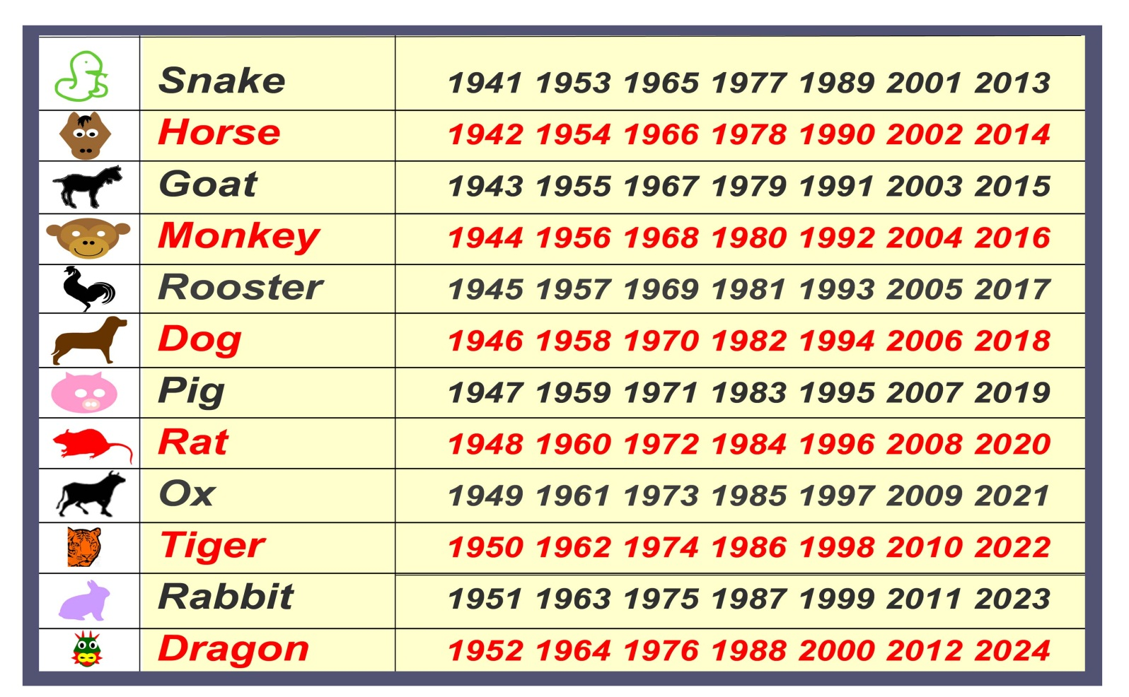
2015 the Year of the Green Sheep
Zodiac sign of the Sheep
Next year of the Green sheep will be in 60 years.
Notes:
The Horse is spirited and energetic, was born to race and thrives in competition. A vigorous horse with the evergreen and renewal characteristics of Wood can mean for this year that this is the time to act!
This will be the year to gallop and take off, literally, this is a good year for adventure and travel, for starting a new business, for buying a home... This is not the year for planning and contemplating, cautiousness was last year's business.

Slide 4
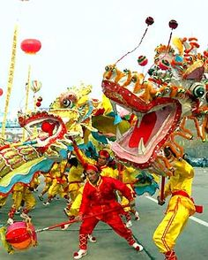

Slide 5
Dragon Dance Parade
The dance represents the sending away of evil spirits.
It is believed that the longer the creature, the more luck it will bring.
The colors of dragons in each dragon dance convey different messages.
For example, green is sometimes selected as a main color of the dragon, which symbolizes a great harvest for the year to come. Other colors include: yellow symbolizing the empire, golden or silver colors representing prosperity, and red color representing excitement while its scales and tail are mostly beautiful silver colors and glittering which creates the joyous atmosphere for Chinese New year celebration.
Notes:
For example, green is sometimes selected as a main color of the dragon, which symbolizes a great harvest for the year to come. Other colors include: yellow symbolizing the empire, golden or silver colors representing prosperity, and red color representing excitement while its scales and tail are mostly beautiful silver colors and glittering which creates the joyous atmosphere for Chinese New year celebration.

Slide 6
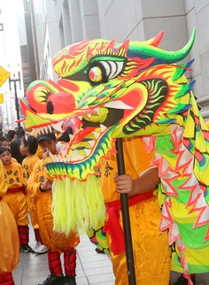

Slide 7
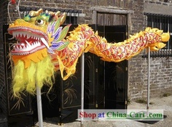

Slide 8
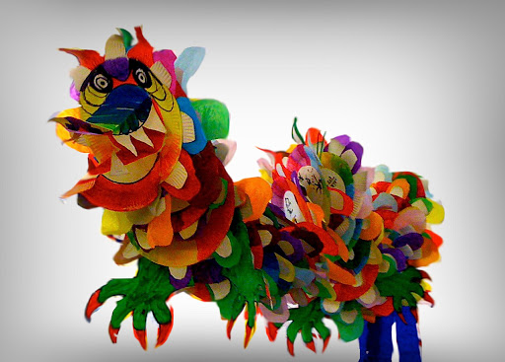
Chinese Dragons
Notes:
Horned Dragon (lung) most powerful generalized type of Chinese dragon, which can produce rain and is totally deaf.
Winged Dragon
Celestial Dragon (which supports and protects the mansions of the gods)
Spiritual Dragon (generates wind and rain for the benefit of mankind)
Dragon of Hidden Treasures (which keeps guard over concealed wealth)
The Coiling Dragon (which lives in water)
The Yellow Dragon (which once emerged from water and presented the legendary Emperor Fu Shi with the elements of writing)
Homeless Dragon (Ii) that lives in the ocean and another type (chiao) that is scale-covered and usually inhabits marshes but also keeps dens in the mountains.
Dragon King, which actually consists of four separate dragons, each of which rules over one of the four seas, those of the east, south, west, and north

Slide 9
Origins of the Chinese Dragon
Theory: they might have been stylized evolutions of the saltwater crocodile. This particular reptile was known for sensing rainfall, and dragons themselves have a strong association with rainfall, storms, and floods. Conceivably, crocodile representations could have evolved to more fanciful representations that resemble the dragons we know today.
Notes:
Although scholars can't come to agreement on the precise origin of the first Chinese dragons, there are theories that they might have been stylized evolutions of the saltwater crocodile. This particular reptile was known for sensing rainfall, and dragons themselves have a strong association with rainfall, storms, and floods. Conceivably, crocodile representations could have evolved to more fanciful representations that resemble the dragons we know today.

Slide 10
Fun Facts
The more toes a dragon has (up to five) the more "regal" it is.
The Chinese refer to themselves "Children of the Dragon"
Many of China's emperors believed themselves to be descended from dragons.
The dragon is a combination of many creatures, with the head of a camel, the ears of an ox, horns of a deer, a snake's neck, tiger's paws and eagle's talons.
The dragon is considered the male "yang" to the phoenix's female "yin."

Slide 11
Chinese Zodiac
Of course the Chinese Dragon is important enough to be one of the zodiac signs, with those who boast this sign are said to be graced with power, strength, and grace.
Of the Dragon zodiac, there are five types:
Wood Dragon
Fire Dragon
Earth Dragon
Metal Dragon
Water Dragon

Slide 12
Other types of Dragons
Horned Dragons: Deemed to be most powerful.
Winged Dragons: Have the fortune of flight and celestial access
Celestial Dragons: Protector of the gods
Spiritual Dragons: Dragons of wind and rain
Hidden Treasures Dragon: Guard concealed wealth
Coiling Dragons: Live in water.
Yellow Dragon: Brings gifts of knowledge to humankind
Dragon King: one to rule each cardinal direction
Earth Dragon: rules the dominion of rivers and lakes
Notes:
Horned Dragon (lung) most powerful generalized type of Chinese dragon, which can produce rain and is totally deaf.
Winged Dragon
Celestial Dragon (which supports and protects the mansions of the gods)
Spiritual Dragon (generates wind and rain for the benefit of mankind)
Dragon of Hidden Treasures (which keeps guard over concealed wealth)
The Coiling Dragon (which lives in water)
The Yellow Dragon (which once emerged from water and presented the legendary Emperor Fu Shi with the elements of writing)
Homeless Dragon (Ii) that lives in the ocean and another type (chiao) that is scale-covered and usually inhabits marshes but also keeps dens in the mountains.
Dragon King, which actually consists of four separate dragons, each of which rules over one of the four seas, those of the east, south, west, and north

Slide 13
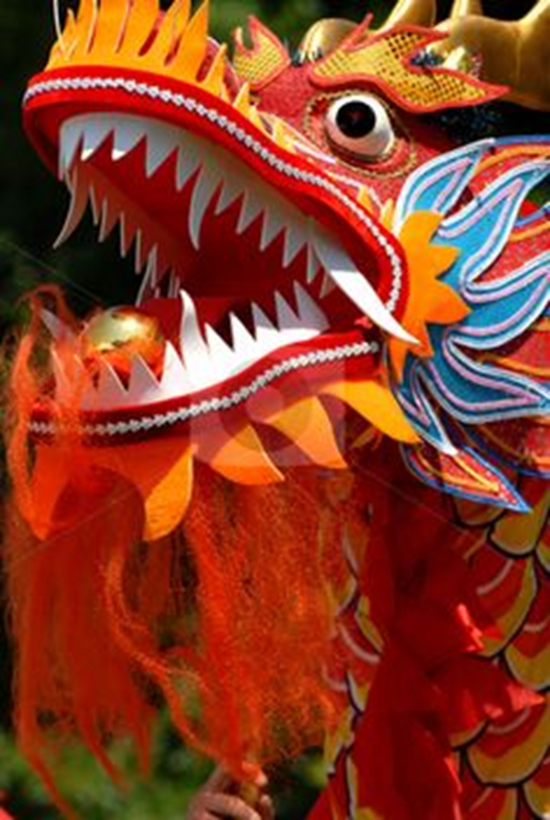
The Dragon Parade is a highlight of the festivities. The Dragon represents wisdom, power, and wealth and a very important aspect of Chinese Culture. It is also said that the Dragon Dance performed on New Year's Day scares away the evil spirits and all the bad luck with them...
Let’s take a look at one now!

Slide 14
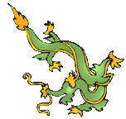
Ancient Chinese DRAGONS
Written by Lin Donn
Illustrated by Phillip Martin

Slide 15
Ancient China
Today, we know that magical dragons exist only in imagination and myth. They are mythical creatures.
But in ancient China, the people firmly believed that dragons were real and powerful. The dragon was the sign of the emperors.
Over time, “The Dragon” became a nickname for China.
Notes:
Teacher Notes:

Slide 16
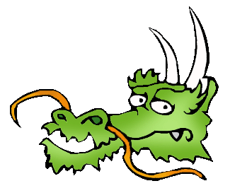
Ancient China
In ancient China, dragons were thought to be wise, caring, and a bit mischievous.
They did not breathe fire. They had personalities. They had magical powers.
They could appear and disappear whenever they wanted.
They could turn into beasts if they were angry.

Slide 17
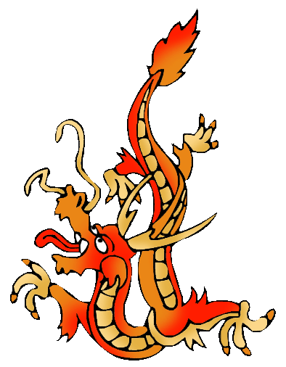
Ancient China
Dragons in ancient China were a composite (a mix) of parts from different animals.

Slide 18
Ancient China
These mythical creatures had
a camel head,
a snake neck,
fish scales,
eagle claws,
tiger paws,
ox ears,
deer horns,
and whiskers.

Slide 19
Ancient China
Their job in ancient China was to act as guardians.

Slide 20
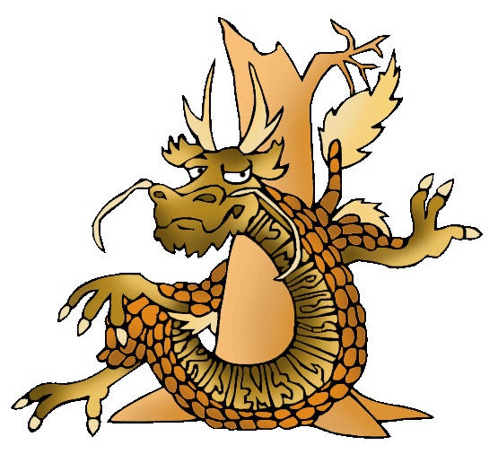
Wood Dragons
Legend says …. Wood dragons are brown.
They guard the forest. They are imaginative and curious, and come up with brilliant new ideas.
They are not as selfish as the other dragons. They share well.

Slide 21
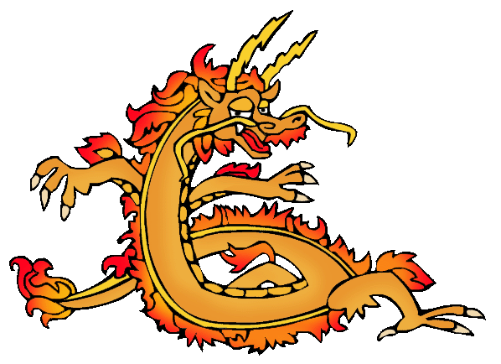
Fire Dragons
Legend says …. Fire dragons are red.
They guard the wind, fire, lightning and sky.
These dragons are the most
outgoing and short-tempered.

Slide 22
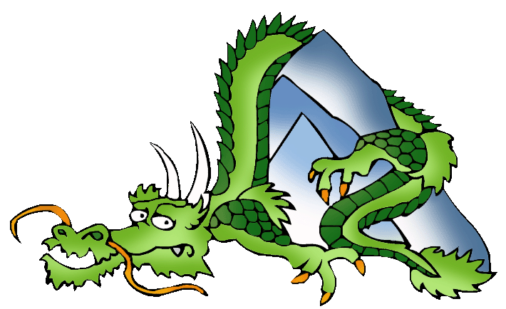
Earth Dragons
Legend says … Earth dragons are green.
They guard the earth, the crops, and the mountains.
They know the value
of cooperation.

Slide 23
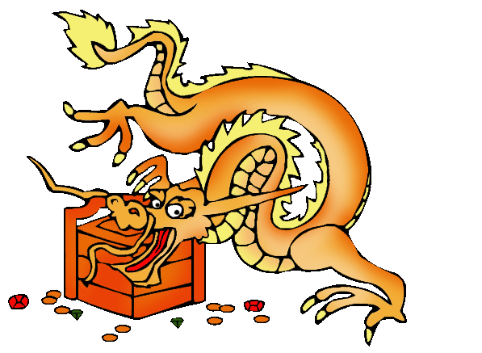
Metal Dragons
Legend says …. Metal dragons are gold.
They guard metals and precious gems. These dragons succeed because they refuse to accept failure.
They have little caring for the feeling of others. These dragons are quite selfish.

Slide 24
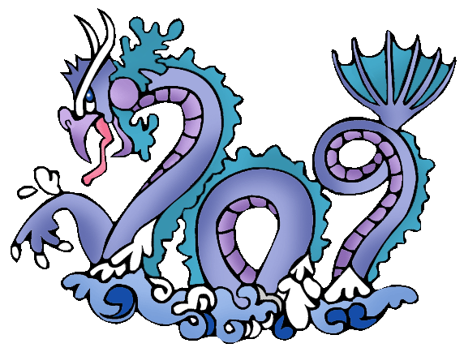
Water Dragons
Legend says …. Water dragons are blue.
They guard rivers, rain, wells, and water. They get along well with people.
They know how to accept defeat and how to rebuild.

Slide 25
Conclusion
Since the ancient Chinese firmly believed that dragons were real and had special magical powers, dragons were an important part of ancient Chinese daily life.
They were blamed for a great deal that went wrong, and credited with things that went right.
Dragons were (and still are) a fun ancient Chinese invention!
Notes:
Teacher Notes:

