Slide 1
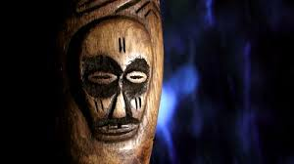
African Masks
Mr.Poole, 7th grade creative arts

Slide 2
Objective
Students will be able to gain information about African Masks necessary for constructing their own African Mask, through the use of a slideshow and youtube

Slide 3
Essential Questions
What is the purpose of an african mask?
How can features of an african mask give it meaning?

Slide 4
Behind the mask
What are African Masks used for?
What is a characteristic of an African Mask?
What do different African Masks represent?

Slide 5
Behind the mask
African Masks were used for rituals and ceremonies. It is believed that the mask maker could contact spirits.
African Masks were stylized, so the mask did not look like a normal human face
An african mask represented what the person wearing it wanted. A bulging forehead meant wisdom, while a large chin represented power and strength

Slide 6
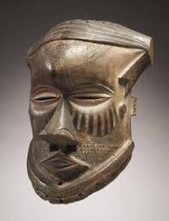
What is something unique about this
mask?
Describe this mask as if the person you’re
talking to can't see it
What does this mask represent?
Why do you say that?

Slide 7
Identify the mask
This mask represents wisdom because of the bulging forehead. The larger forehead represented a larger brain

Slide 8
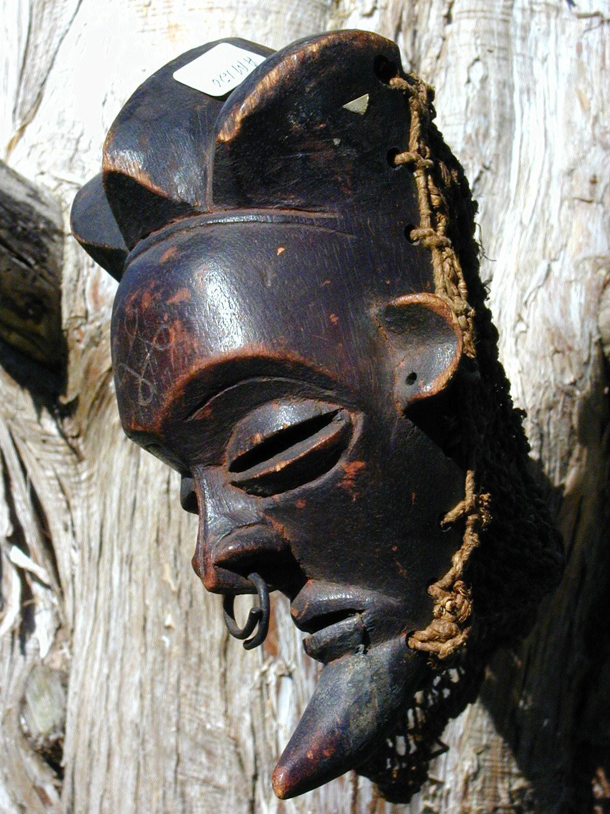
What is something unique about this
mask?
Describe this mask as if the person you’re
talking to can't see it
What does this mask represent?
Why do you say that?

Slide 9
Identify the mask
This mask represents power and strength because of the large chin

Slide 10
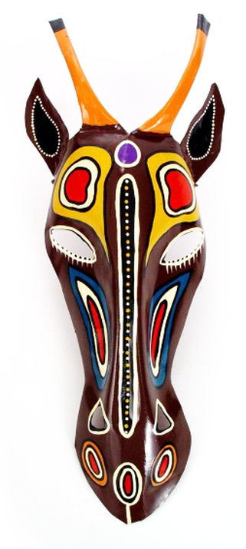
What is something unique about this
mask?
Describe this mask as if the person you’re
talking to can't see it
What does this mask represent?
Why do you say that?

Slide 11
Identify the mask
This antelope mask symbolizes agriculture and is worn to enable better crops. Horns represent growth of millet, legs roots of the plants while ears represent songs that women sing in the harvest time

Slide 12
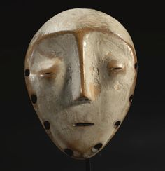
What is something unique about this
mask?
Describe this mask as if the person you’re
talking to can't see it
What does this mask represent?
Why do you say that?

Slide 13
Identify the mask
This mask represents humility because of the extremely small mouth and eyes

Slide 14
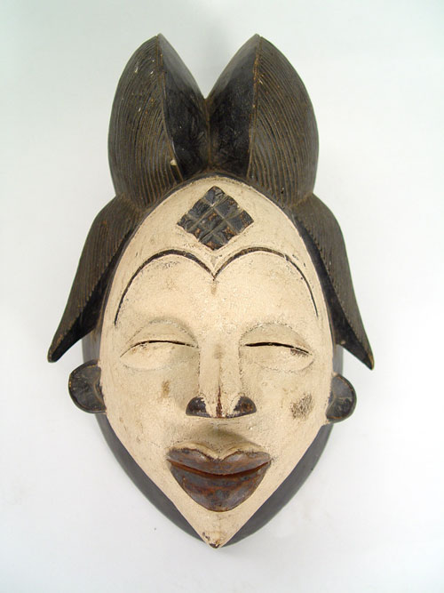
What is something unique about this
mask?
Describe this mask as if the person you’re
talking to can't see it
What does this mask represent?
Why do you say that?

Slide 15
Identify the mask
This mask represents feminine beauty because of the almond shaped eyes, large lips, and structure of a female face

Slide 16
Sources
http://www.historyofmasks.net/mask-history/history-of-african-masks/

