Slide 1
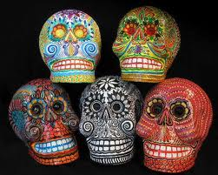
EL DIA DE LOS MUERTOS
The Day of the Dead

Slide 2
BACKGROUND
El Día de los Muertos, or the Day of the Dead, is a holiday that is celebrated in Mexico and other Spanish-speaking countries on November 2nd.
Some of the traditions that are observed on el Día de los Muertos date all the way back to the Aztec empire!
When the Spanish arrived, they mixed the old indigenous (native) traditions with their own Catholic faith.

Slide 3
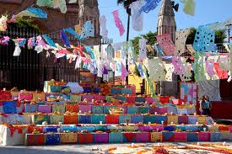
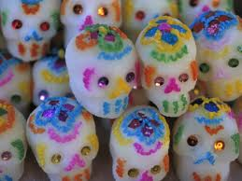
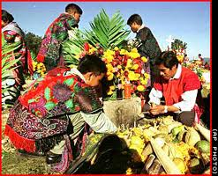
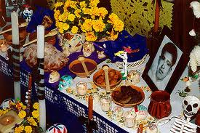
The Celebration
El Día de los Muertos is celebrated differently from region to region, but all celebrations have common features:
Colorful decorations
Reunions in cemeteries
Special Foods
Commemorative offerings for the departed

Slide 4
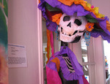
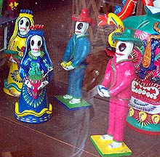
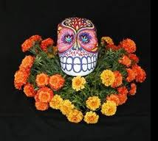
Decorations
Decorations for El Día de los Muertos often include images of La Catrina - a fully-dressed skeleton, often with a large hat - as well as papel picado – brightly colored, cut tissue paper. Yellow and orange marigolds and colorfully decorated skulls and skeletons are also commonly-used decorations.

Slide 5
A cemetery decorated with papel picado

Slide 6
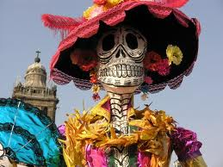
La Catrina

Slide 7
Calacas, homemade skeletons used for decoration

Slide 8
Yellow and Orange marigolds are used to decorate tombs and altars.

Slide 9
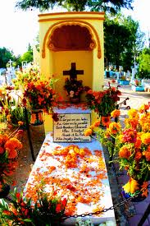
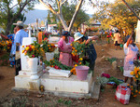
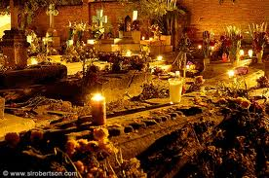
Cemetery Visits
In rural Mexico, people visit the cemetery where their loved ones are buried. They decorate gravesites with marigold flowers and candles. They bring toys for dead children and food and drinks to adults. They sit on picnic blankets next to gravesites and eat the favorite food of their loved ones.

Slide 10
Yellow and Orange marigolds are used to decorate tombs and altars.

Slide 11
Families decorate tombs with orange and yellow marigolds and bring gifts for the deceased.

Slide 12
Family members decorate tombs with orange and yellow marigolds and bring food and drinks for the deceased..

Slide 13
Candles burn overnight at a cemetery decorated for el Día de los Muertos.

Slide 14
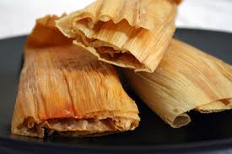
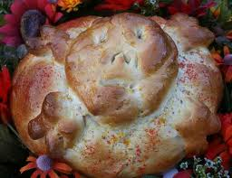
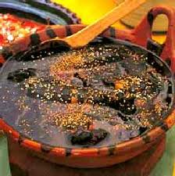
Special Foods
El Día de los Muertos is known for the elaborate sugar skulls which are made and decorated especially for this holiday. Pan de muertos (bread of the dead) is also popular among children, and is also placed as part of many offerings. Many families make tamales or mole for the family gatherings, and as an offering for the deceased.

Slide 15
Sugar skulls are made and sold for decorating altars and for kids to eat ☺

Slide 16
Pan de muertos is made and sold for decorating altars and eating during the holiday.

Slide 17
Many families make tamales to include in the offering for the deceased and to eat as a family.

Slide 18
Mole is another popular food that is prepared in honor of the deceased.

Slide 19
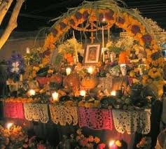
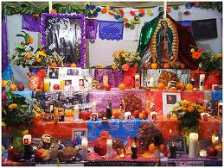
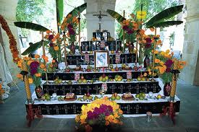
Offerings
In their homes, family members honor their deceased with ofrendas, or offerings, which may consist of photographs, bread, other foods, flowers, toys and other symbolic offerings. Most altars include things like water, soap, and a towel for the dead to cleanse themselves. Some altars may also include favorite items of the deceased that might serve them on their journey.

Slide 20
Altars are brightly decorated with papel picado, religious symbols, and images of deceased loved ones.

Slide 21
Candles burn on decorated altars to light the way for the spirits of the deceased.

Slide 22
Food and water are part of the ofrenda left for the spirits of the deceased.

Slide 23
Altars may include multiple levels of images, food, drinks, flowers, candles, and other decorations.

