Slide 1
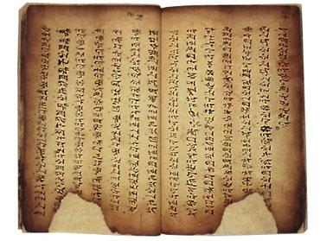
Illuminations
A lesson in the art of Illuminated letters
by Sheri Rinehuls

Slide 2
Essential Questions?
Questions to think about while working on this assignment:
What do Illuminated Manuscripts tell us about human beings and the idea of communication?
How can imagery enhance the communicative value of a text?
What should we take into consideration when designing imagery for a text?
How are Illuminated Manuscripts , picture books, comic books, web pages, magazines, etc. related?

Slide 4
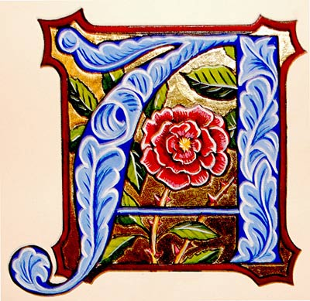
Project Requirements
Detailed Border/Ruled Lines
Decorated Lettering style
Recognizable Letter
Centered Letter
First letter of first or last name
Illusion of Depth - Dimension
A Detailed object/symbolism/etc.
Space must be filled
Must be traced with sharpie
No pencil lines showing
Gold highlights

Slide 5
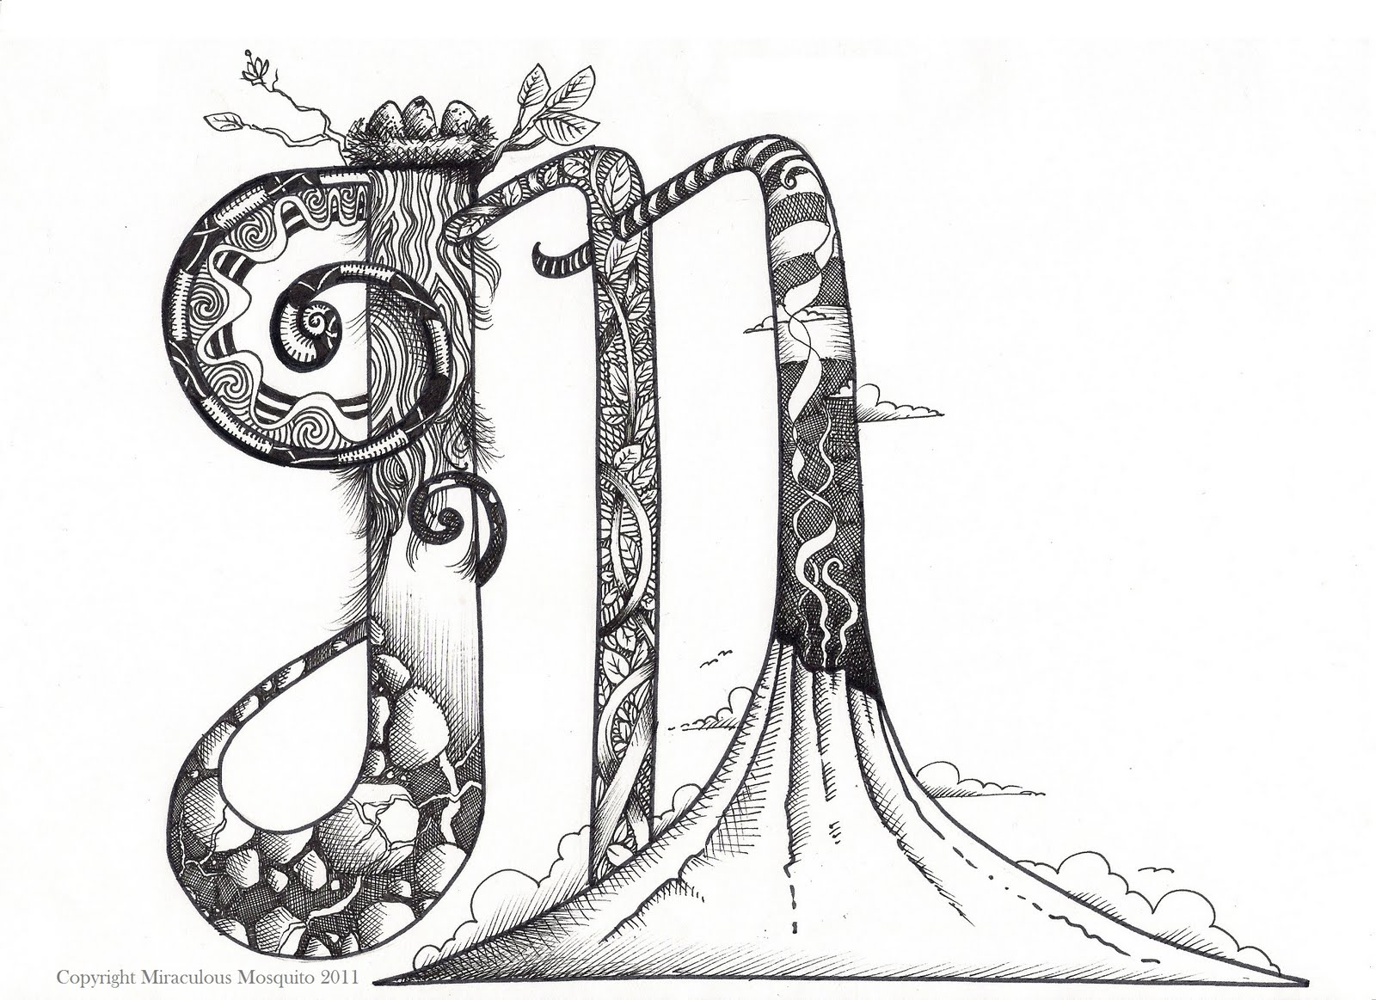
Think outside the box
Does the letter have to be straight on compositionally?
Does the border have to contain the letter/background?\
Think of contrast…..
Size- big/small
Colors – color theory
Shapes – organic/geometric
Value
Texture/pattern
Unity

Slide 6
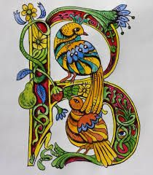
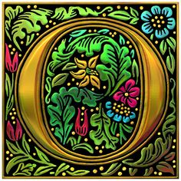
How can you make one you ask?
what you’ll need::
- A piece of drawing paper
- A pencil and eraser
- A ruler
- An idea of what letter you want to create, perhaps your initial.
- A theme you are going to base your letter around, for example a mythological
creature, or a variety of plants.
- A black fine tip sharpie marker
- Colored pencils, crayon, paint for color and gold glue for gold leaf

Slide 7
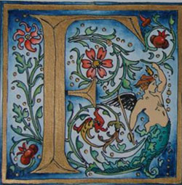
How can you make one you ask?
STEPS TO FOLLOW:
CREATE YOUR BOARDER
MAKE YOUR LETTER WITHIN THE BORDER
ADD YOUR DETAILS AROUND YOUR LETTER AND BORDER
ONCE YOU ARE HAPPY WITH YOUR DESIGN, TRACE EVERYTHING IN SHARPIE
ERASE YOUR PENCIL LINES
TRACE YOUR LETTER WITH THE GOLD GLUE
ADD COLOR
RETRACE YOUR SHARPIE LINES.

Slide 8
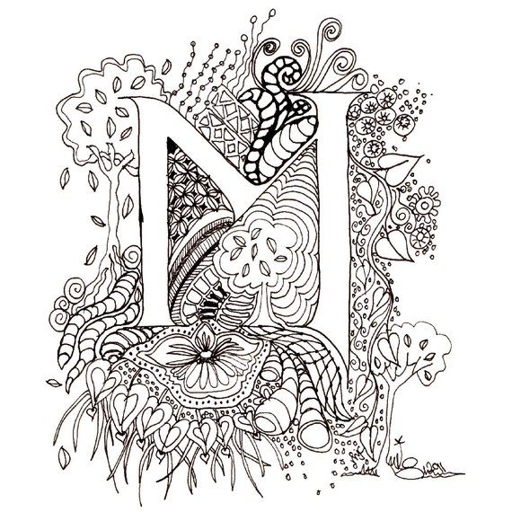
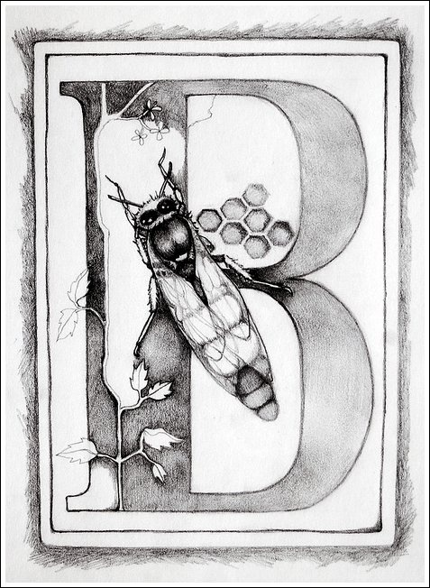

Slide 9
