Slide 1
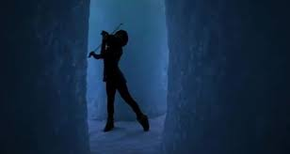
To start our culture lesson, we will be listening to music. As you listen, think about the following questions:
https://www.youtube.com/watch?v=P-yGqJCOJxw&x-yt-ts=1422579428&x-yt-cl=85114404&feature=player_detailpage
What do you notice?
What do you wonder?
What do you think? Provide evidence (that you noticed) to support your claim.

Slide 2
Objective:
Describe aspects of culture

Slide 3
What is culture?
The customs, traditions, beliefs and values that a group of people share.
It includes language, what they do, eat, make, believe and how they dress.
Groups that share these traits are called a cultural group.

Slide 4
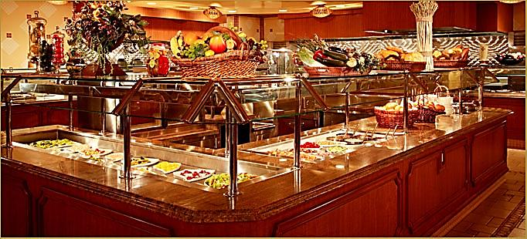
How is Creative Arts like a buffet?
Consider the picture.
What do you notice?
What do wonder?
What do you think?

Slide 5
Intro – Personal Interview Questions Let’s get to know you!!!
Interview the person next to you using the question sheet provided
Make up a question of your own to ask your partner (15 min)
Share one question and answer about your partner

Slide 9
Culture is like a kaleidoscope, continually changing based on contact.

Slide 10
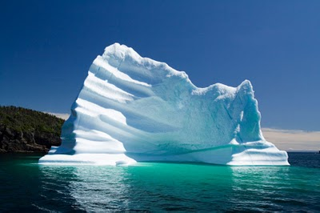
What is culture?
How is culture like an iceburg??

Slide 11
▶ 2:51
www.youtube.com/watch?v=UG7n5KnKPm0
https://www.youtube.com/watch?v=NSCFxDKJWwo

Slide 12
What do you think about culture
How is culture like and iceberg?
Some things you can directly observe with your eyes. And others you have to dig deeper into the culture to understand.
Observable (above)
What can you see
Invisible (below)
Really only understood by the specific culture
On a blank piece of paper, provided and decide what aspects of culture are Observable or Invisible.

Slide 13
Find five… list at least five aspects of culture that you…
Can visibly see (above)
Probably can’t see (below)

Slide 14
Invisible Aspects of Culture (Below):
values
concept of beauty
concept of fairness
childraising beliefs
understanding of the natural world
religious beliefs
importance of time
concept of self
concept of leadership
nature of friendship
general world view
work ethic
rules of social etiquette
concept of personal space
notions of modesty
Observable Features of Culture (Above):
facial expressions
religious rituals
paintings
holiday customs
gestures
foods
eating habits
music
literature
styles of dress

Slide 15
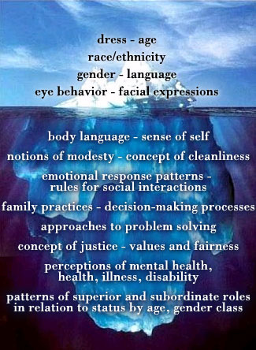
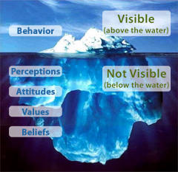
Culture is like an Iceberg…

Slide 16
What is culture?
Culture is the characteristics of a particular group of people, defined by everything from language, religion, cuisine, social habits, music and arts.

Slide 17
video
How does this video represent culture to you?
What do notice?
What do you wonder?
What do you think?

Slide 18
By exploring culture you can better…
_ nd_ rst_ nd
_ ppr_ c_ _ t_
r_ l_ t_
c_ nn_ ct
understand
appreciate
relate
connect

Slide 19
By understanding culture you are less likely to…
__ ns__ lt
__ ff__ nd
d__ sm__ ss
__ xcl__ d__
__ gn__ r__
insult
offend
dismiss
exclude
ignore

Slide 20
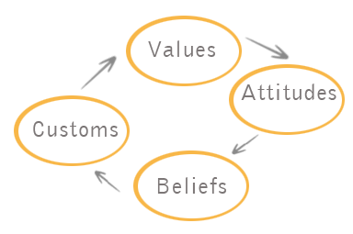

Slide 21
Check for understanding… Complete each sentence starter to show what you have learned. Culture is (means)… Culture is not (does not mean)…

Slide 22
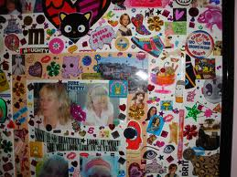
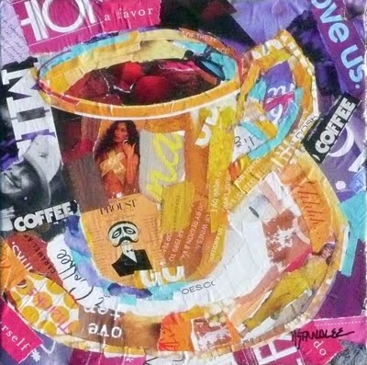
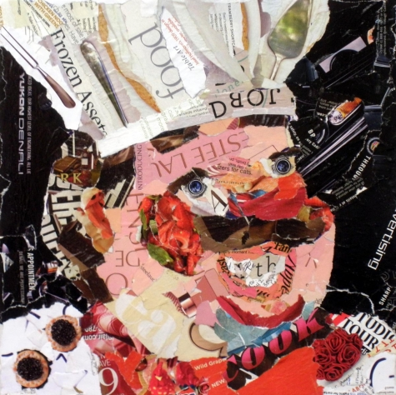
Who are you? Exploring the concepts of culture + self-expression Challenge: How can you use technology to represent who you are?

Slide 23
Think about your culture and how you want to represent yourself.
Your creative challenge is to use a combination of text, sound, and images to express who you are.
You are to experiment with Google Slides to create a presentation about yourself and your culture. You will be sharing with the class.

Slide 24
MUST HAVES:
You must have at least 8 slides
Slide 1 must be your opening / introduction slide. This slide must include the objective for the lesson, The title of your presentation, Your name, a picture of you, and anything else that would make it interesting and unique to you.
Slides 2, 3, and 4 should be observable aspects / features of culture that represent you.
Slides 5, 6, and 7 should be invisible aspects of culture that represent you. *Remember, this will be shared with the class so only include what you are comfortable with.
Slide 8 must be your ending slide / Credits
You must include an interesting background, pictures that represent you (found online or photographs you have), words, sound, etc..
This is an art class – must be visually pleasing
Have fun!!!
We will present on Thursday!!!!!

Slide 25
Write a list of things that are meaningful to you, things you love, or things that represent you.
Reflection Question:
What did you learn from today’s class to better
Understand yourself or others?
3. Homework: upload images or put on a flash drive of you, your family, your pets, etc. That you may want to include in your slide presentation.

