Slide 1
Mardi Gras
Et Carnaval

Slide 2
The History of Mardi Gras
Mardi Gras came to New Orleans through its French heritage in 1699. Early explorers celebrated this French Holiday on the banks of the Mississippi River. Throughout the years, Orleanians have added to the celebration by establishing krewes (organizations) which host parades and balls. Carnival quickly became an exciting holiday for both children and adults.
http://www.holidays.net/mardigras/story.htm

Slide 3
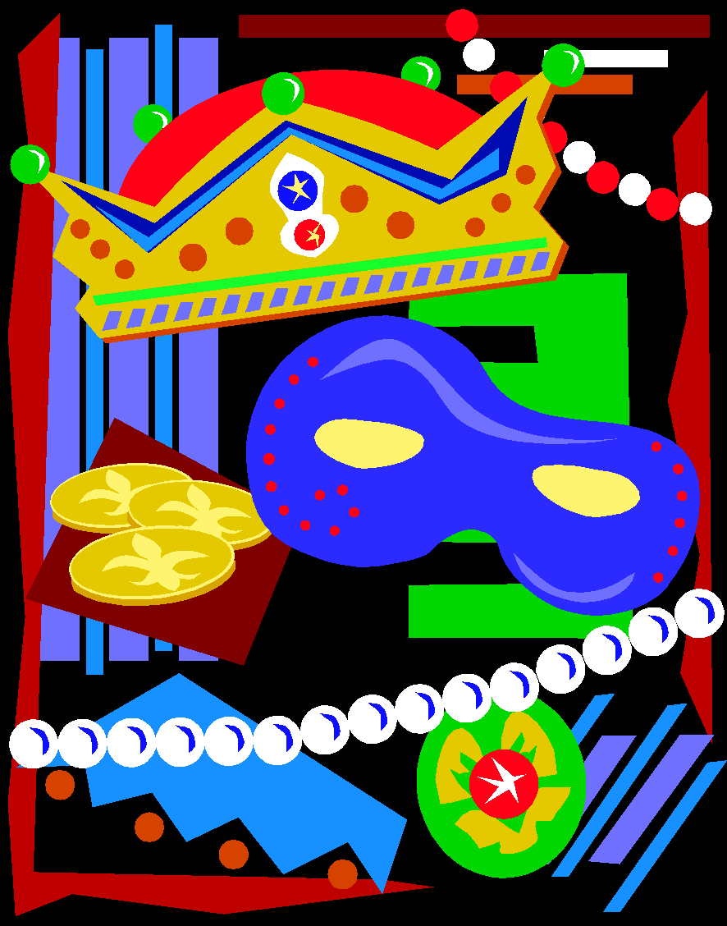
What is Fat Tuesday?
Mardi Gras means "Fat Tuesday" and of course is celebrated on that day of the week. The date can fall between February 3 and March 9 depending on the Lunar calendar, used by the Catholic Church to determine the date of Easter. Mardi Gras is always 47 days before Easter Sunday.
http://www.holidays.net/mardigras/story.htm

Slide 4
The official colors for Mardi Gras are purple, green, and gold. These colors were chosen in 1872 by the King of Carnival, Rex. He chose these colors to stand for the following:
Purple represents justice
green stands for faith
gold stands for power
http://www.holidays.net/mardigras/story.htm

Slide 5
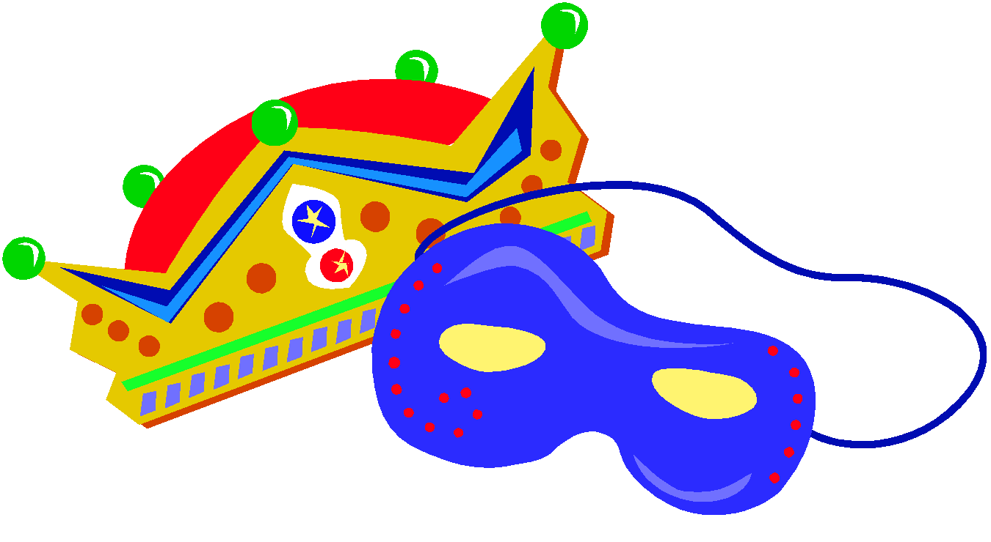
The Mardi Gras season begins on January 6 and continues until Fat Tuesday, the day before Ash Wednesday. On the Christian calendar, the twelfth day after Christmas is known as "Epiphany", "Twelfth Night", or "Kings Day." It is the day the gift-bearing Magi visited the baby Jesus, and is celebrated with its own unique rituals.
http://www.holidays.net/mardigras/story.htm

Slide 6
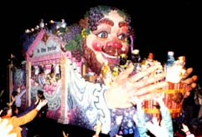
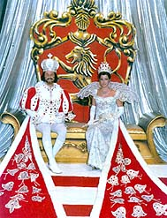
Parades are put on by carnival krewes (or organizations). Every year, each krewe picks a king and a queen who reign for that parade. The floats are decorated to depict different themes. The floats are pulled by tractors. Most parades have at least 15 floats.
http://www.holidays.net/mardigras/story.htm

Slide 7
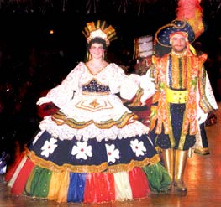
Following the parade, the krewe usually has a ball presenting their king and queen, and their royal court. The royal court includes maids, dukes, pages, captains, and jesters.
http://www.holidays.net/mardigras/story.htm

Slide 8
Beads are plastic necklaces that come in all different colors, shapes and sizes. They resemble jewels that royalty would wear.
http://www.holidays.net/mardigras/story.htm

Slide 9
Doubloons are metal coins that are about the size of a silver dollar. They come in different colors and are stamped with the krewes emblem and their theme for the year.
http://www.holidays.net/mardigras/story.htm

Slide 10
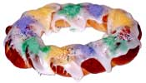
As part of the celebration of Mardi Gras, it is traditional to bake an oval cake in honor of the three kings - the King Cake. The shape of a King Cake symbolizes the unity of faiths. Each cake is decorated in the traditional Mardi Gras colors: purple represents justice, green represents faith and gold represents power. A small baby, symbolizing the baby Jesus, is baked into each cake.
http://www.holidays.net/mardigras/story.htm

