Slide 1
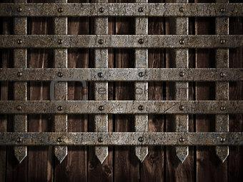
Medieval Portraits
Day 1
Mr. Poole, 7th grade Creative Arts

Slide 2
Objective:
By the end of this lesson, we will be able to identify characteristics of Medieval portraiture. We will be observing and analyzing the details of Medieval portraits through the use of a slide show presentation.

Slide 3
Essential Questions
How can looking at the style of a Medieval person help out when creating a portrait?
What does the style or pose of a person during the medieval century tell us about them?

Slide 4
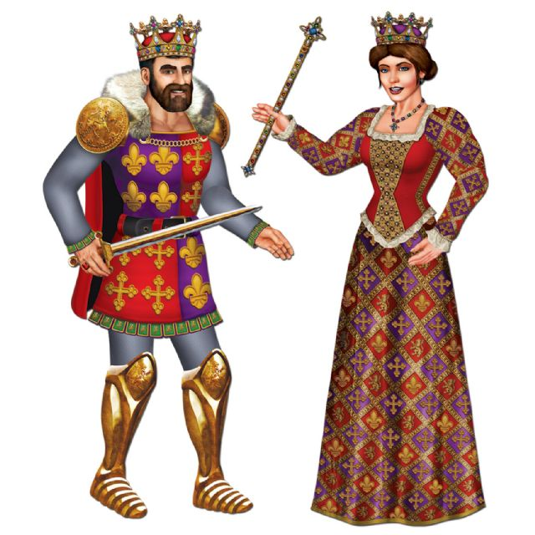
What are the people in this portrait wearing?
What do the clothes tell us about them?
Can you describe their personality by looking at them?
Who do you think these people are? How do you know?

Slide 5
Kings
Medieval Kings wore fanciful surcoats with emblems and patterns that made a statement of their wealth
Regalia means Royal things, often used to describe accessories used by a medieval king such as spectres and Orbs
Medieval kings clothing & ceremonial daggers and weapons that were decorated in jewels & precious metals
The most important part of medieval kings clothing was his crown, which really showed off his wealth and status

Slide 6
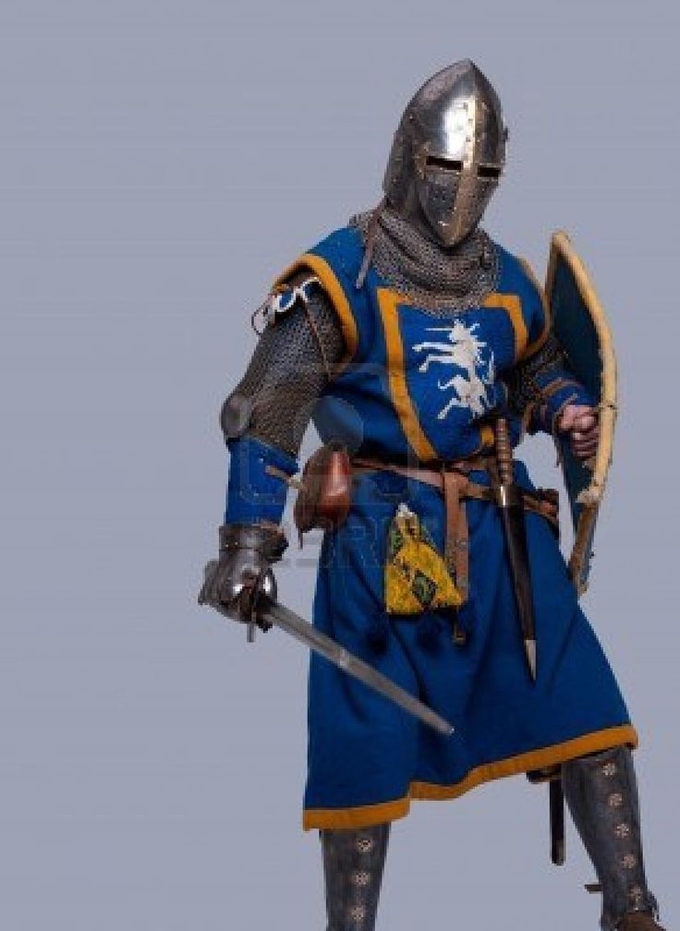
What is the person in this portrait wearing?
What do the clothes tell us about them?
Can you describe their personality by looking at them?
Who do you think this person is? How do you know?

Slide 7
Knights
The social class of the knight was below the Clergy, Merchant, and King/Queen, but above peasants
The purpose of the knight was to battle
The armour of a knight went in 3 stages
Leather armor
Chain mail armor
Plate mail armor

Slide 8
Knights
Leather Armor- Knights could fasten leather as armor to protect most of their body, even though it was hard they were still vulnerable to sword thrusts and arrows
Chain Mail Armor- Could be fastened to any part of the body, metal rings assembled together to create protection. Even though the material was strong, it only protected against slashes
Plate Mail Armor- Composed of metal to protect a certain region of the body (Ex. Helmet, chest plate. Protected against piercing attacks but was expensive.

Slide 9
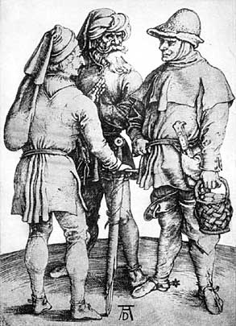
What are the people in this portrait wearing?
What do the clothes tell us about them?
Can you describe their personality by looking at them?
Who do you think these people are? How do you know?

Slide 10
Merchants
Merchants wore a surcoat that would end above their knees
The coats would be of a bright colour and could have a trim of fox fur. A belt with a purse attached was worn
To keep warm the merchant class wore stockings or tights
The merchants wore shoes with long tips, which used to be so long sometimes that they had to be fastened to the knees with jeweled chains

Slide 11
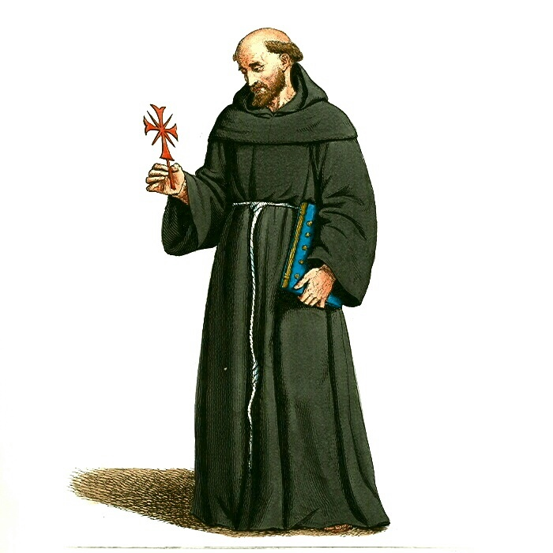
What are the people in this portrait wearing?
What do the clothes tell us about them?
Can you describe their personality by looking at them?
Who do you think these people are? How do you know?

Slide 12
Clergy
Priests were then required to don a tunic, also known as an alb, which flowed down to their feet; this would distinguish them from the laymen who dressed in trousers and walked bare feet
Priests would wrap a belt around their waists and during Mass, they would put on another garment over the tunic. This outer garment would either be a tunic with long sleeves, known as a dalmatic, or a chasuble, a clock without sleeves
Priests also had a piece of fabric over their shoulders, a stole

Slide 13
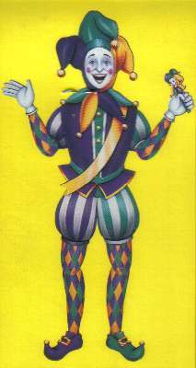
What are the people in this portrait wearing?
What do the clothes tell us about them?
Can you describe their personality by looking at them?
Who do you think these people are? How do you know?

Slide 14
Jester
Clothing worn by the Jester was gaudy, brightly colored, and humorous
The Medieval Jesters hat, called a fool's hat, had 3 points with a jingle bell at the end of each point

Slide 15
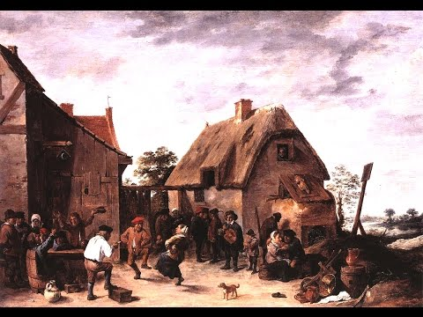

Slide 16
Medieval Portraits / Proportion
Day 2
Mr. Poole, 7th grade Creative Arts

Slide 17
http://www.medievalchronicles.com/medieval-clothing/medieval-queens-clothing/
http://www.medievalchronicles.com/medieval-clothing/medieval-kings-clothing/
http://www.medieval-life-and-times.info/medieval-life/medieval-jesters.htm
http://www.thefinertimes.com/Middle-Ages/priests-in-the-middle-ages.html#sthash.esaIPvqn.dpuf
http://www.brighthubeducation.com/history-homework-help/106277-types-of-clothing-worn-during-the-middle-ages/
http://www.medieval-life-and-times.info/medieval-clothing/medieval-noble-clothing.htm

